Slide 1
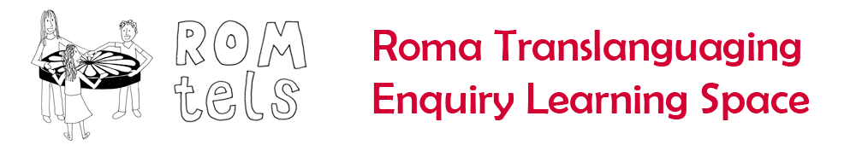







Languages for Dignity: a pedagogy for success at school
Oradea, Romania
26th-27th October 2016
Day 2
Dr Heather Smith
http://research.ncl.ac.uk/romtels/resources/

Slide 2
Stereotyping Roma in Romania
Time to challenge our thinking and address implicit biases.

Slide 3


Let us recall our previous work on stereotyping:
What do we now understand a stereotype to be? What is the relationship between a stereotype, a prejudice and discriminatory acts?
Social fiction applied to groups of people and their relative worth
Acts to essentialise
Easier to notice examples which confirm a stereotype than disconfirm
Stick more strongly and for longer to groups with less political power

Slide 4
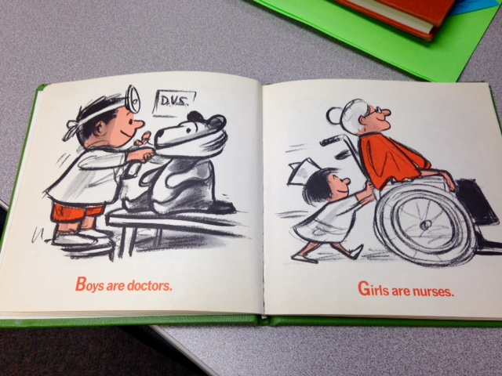
Let us start with some story books ….
Read the children’s story on your table. Work together to spot any stereotyped representation of characters which make assumptions of their relative worth OR anything which acts to counter such stereotypes.

Slide 5
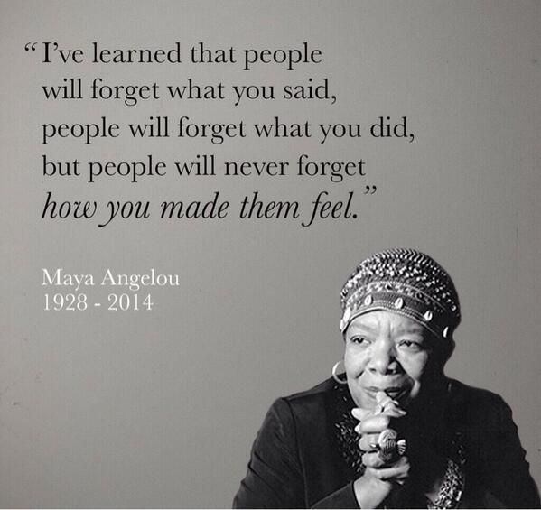
What does it feel like to be stereotyped against?
Let’s play a game …. Talk to each other in groups of 3 about your main goals in life, but react to one and other according to the stereotype label.

Slide 6
Stereotyping of Roma in Romania
Teachers’ expectations and stereotypes can negatively impact Roma students’ school performance, particularly in the case of girls. One study found that, despite the fact that Roma children expressed high aspirations for their future, teachers viewed them as unmotivated and disinterested in studying (Fleck and Rughinis 2008). Stereotypes or expectations that Roma girls will drop out of school to get married seem to influence teachers’ attitudes toward them, and even influence curricula—Roma girls are taught it is very common to marry early in Roma culture, even against evidence from their own communities (Duminica˘ and Ivasiuc 2013).
Fleck, Gabor, and Cosima Rughinis. 2008. Come Closer: Inclusion and Exclusion of Roma
in Present-Day Romanian Society. Report, European Commission, Bucharest.
Duminica˘, G., and A. Ivasiuc. 2013. “The Roma in Romania: From Scapegoat to Development Engine.” Report, “Impreuna˘” Agency for Community Development, Cluj-Napoca. https://www.academia.edu/6037269/IN_ROMANIA_ROMA_From
_Scapegoat to_Development_Engine.

Slide 7
Now consider the most commonly held stereotypes and prejudices against Roma in Romania
Think about a negative stereotype you recently read/saw in the media about Roma
OR think about a conversation you have had recently with a colleague about Roma children/families
OR think about a school policy/practice which is discriminatory against Roma as a result of negative stereotyping.

Slide 8
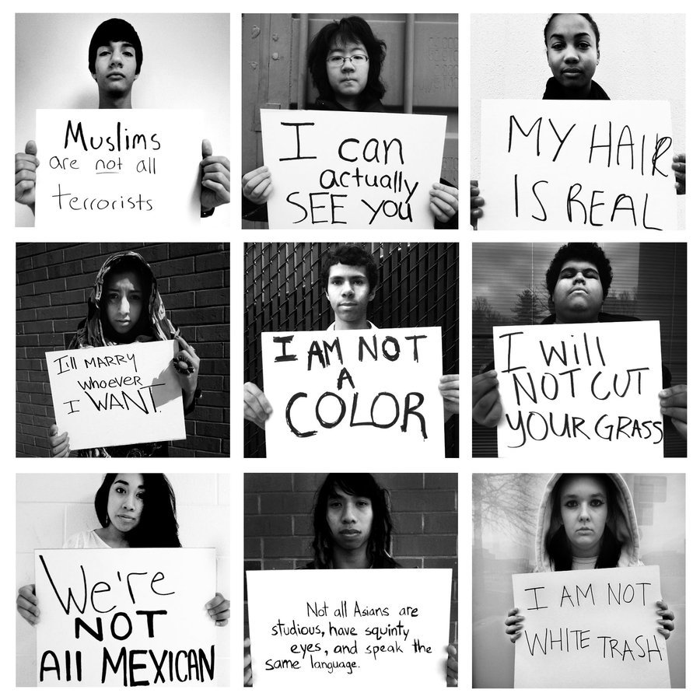
Now let’s think about the possible ramifications of these stereotypes in terms of teacher practices and school policies?
Finally, what are some of the ways these could be countered?

